Slide 1
Marvel & DC SQL Case Study Brown-Eyed Male and Female Marvel Superheroes
By Megan Lieu

Slide 2
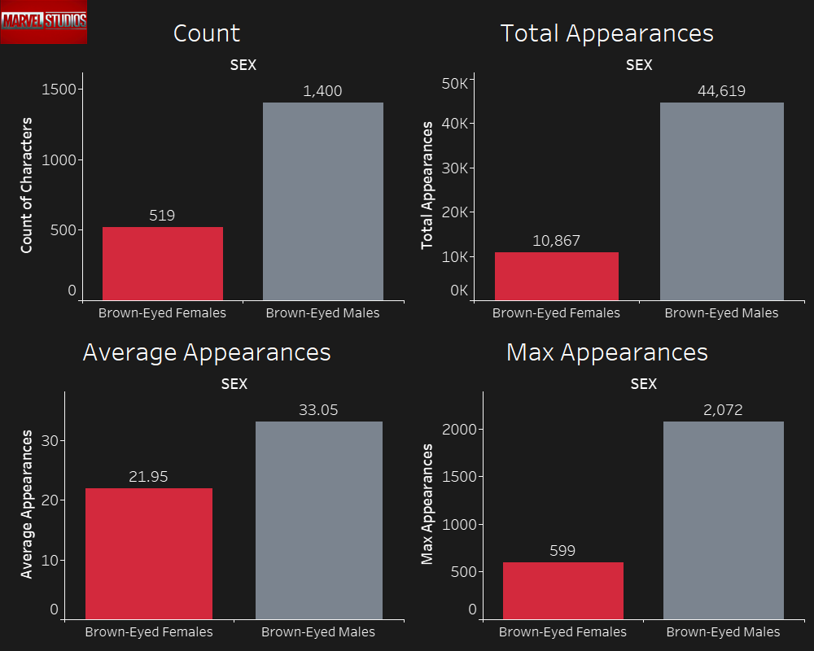

Slide 3
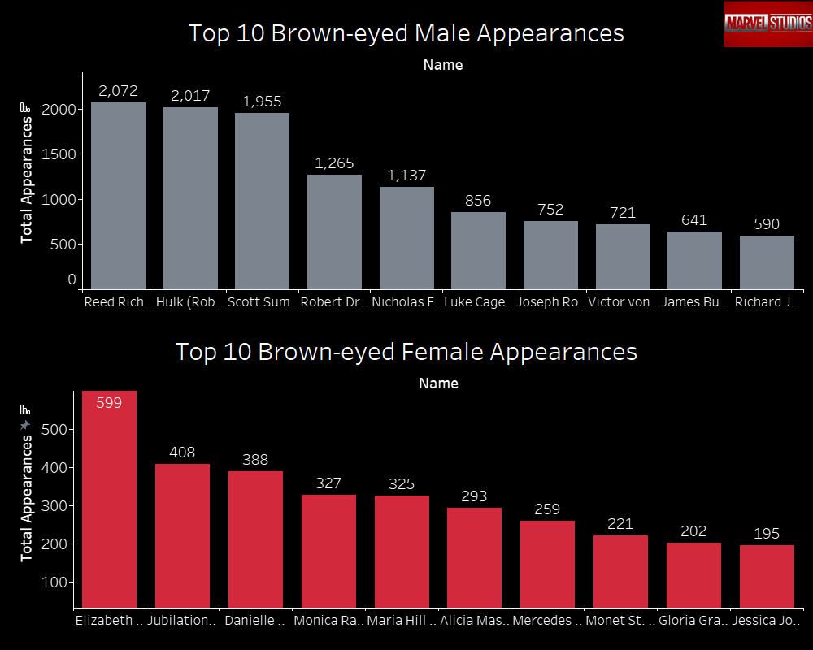

Slide 4
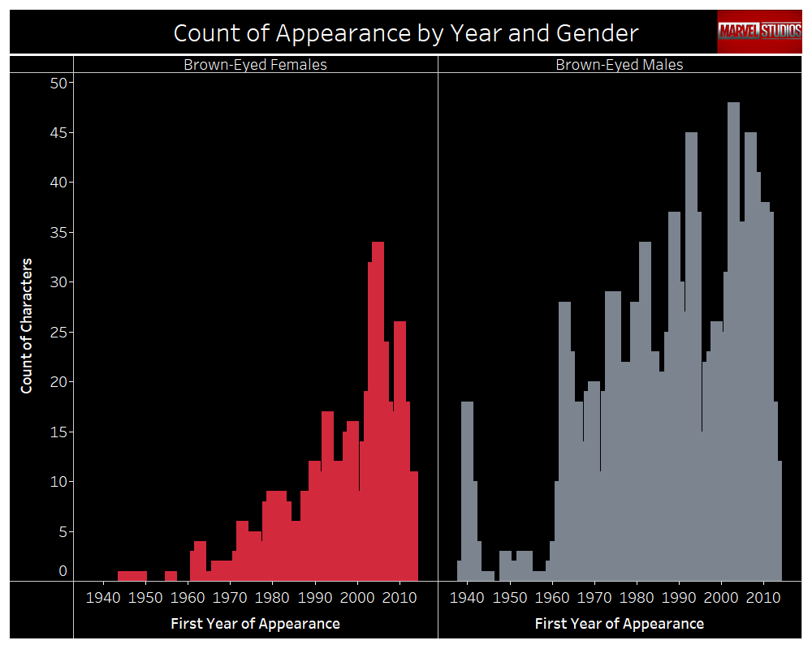

Slide 5
